Slide 1
CS5112: Algorithms and Data Structures for Applications
Association rules
Ramin Zabih
Some content from: Wikipedia/Google image search; Harrington;
J. Leskovec, A. Rajaraman, J. Ullman: Mining of Massive Datasets, http://www.mmds.org

Slide 2
Administrivia
Prelim (midterm) date scheduled for Wednesday October 16
This would ruin your holiday weekend, so we’re delaying it a week
In class, closed book on Wednesday October 23
Review session in class on October 21
HW1 is due by 10/7
We will be more forceful about groups in the future
Lectures will be recorded “Real Soon Now”

Slide 3
Lecture Outline
Unsupervised learning and association rule mining
Some logical identities
Useful ways to think about (discrete) probabilities
Frequent item set data mining
The Apriori algorithm

Slide 4
Learning from big data
The term is ill-defined, but lots of important examples
Fraud detection in credit card transactions
Loyalty programs
Predicting consumer preferences
And exploiting them?
Primarily rely on labeled data
“Supervised learning”
Labeled data is expensive

Slide 5
Unsupervised learning
What can we learn in the absence of a labeled data set?
Main unsupervised areas are:
Clustering (e.g., k-means)
Low dimensional structure (not covered in CS5112)
Associations (today’s lecture)
Digression: semi-supervised learning
Use clusters to propagate a sparse set of labels

Slide 6
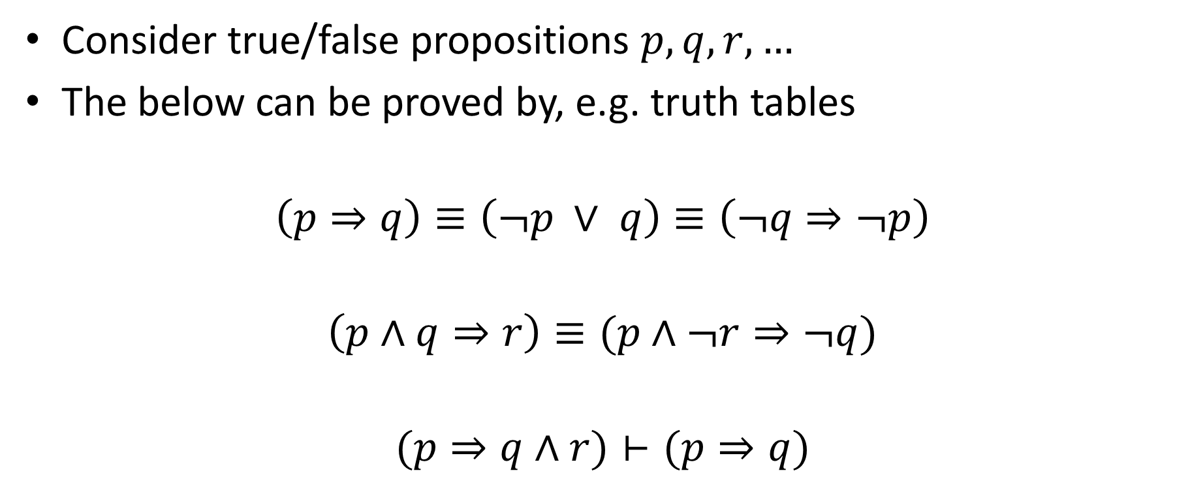
Useful logical identities
Consider true/false propositions $p,q,r,…$
The below can be proved by, e.g. truth tables
$$\left(p⇒q\right)≡\left(¬p ∨ q\right)≡\left(¬q⇒¬p\right)$$
$$\left(p∧q⇒r\right)≡(p∧¬r⇒¬q)$$
$$(p⇒q∧r)⊢(p⇒q)$$
Notes:
Define these symbols. Start with NOT, OR, AND. Others are built up from these.
Triple equals is ‘have the same truth table’
Single turnstile is ‘LHS is a superset of RHS truth table’

Slide 7
Example transactions
Rule discovered: Coke→Diaper

Slide 8
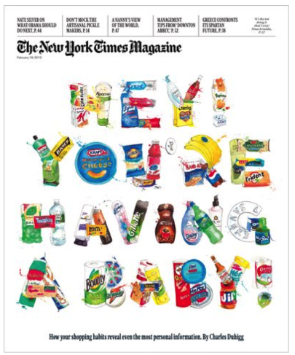
Things can go badly wrong…

Slide 9
Association rules
Learn rules that are supported by your data
Rules are co-occurrence, not causality!
Very clear in the propositional formulation (symmetry)
Beer and diapers legend
What do you do with an association rule?
In practice you don’t want too many of them
Need to act on them

Slide 10
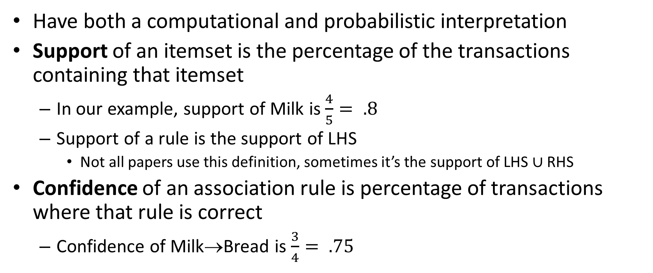
Support and confidence
Have both a computational and probabilistic interpretation
Support of an itemset is the percentage of the transactions containing that itemset
In our example, support of Milk is $\frac{4}{5}= .8$
Support of a rule is the support of LHS
Not all papers use this definition, sometimes it’s the support of LHS $∪$ RHS
Confidence of an association rule is percentage of transactions where that rule is correct
Confidence of Milk→Bread is $\frac{3}{4}= .75$

Slide 11
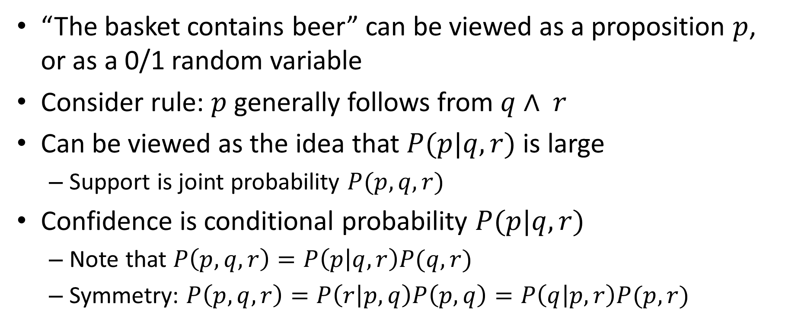
Probabilistic view
“The basket contains beer” can be viewed as a proposition $p$, or as a 0/1 random variable
Consider rule: $p$generally follows from $q∧ r$
Can be viewed as the idea that $P(p|q,r)$ is large
Support is joint probability $P(p,q,r)$
Confidence is conditional probability $P(p|q,r)$
Note that $P\left(p,q,r\right)=P\left(p | q,r\right)P(q,r)$
Symmetry: $P\left(p,q,r\right)=P\left(r | p,q\right)P\left(p,q\right)=P\left(q | p,r\right)P(p,r)$

Slide 12
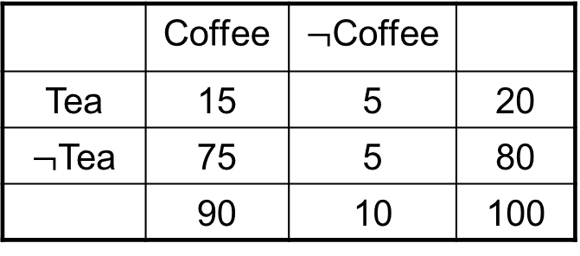
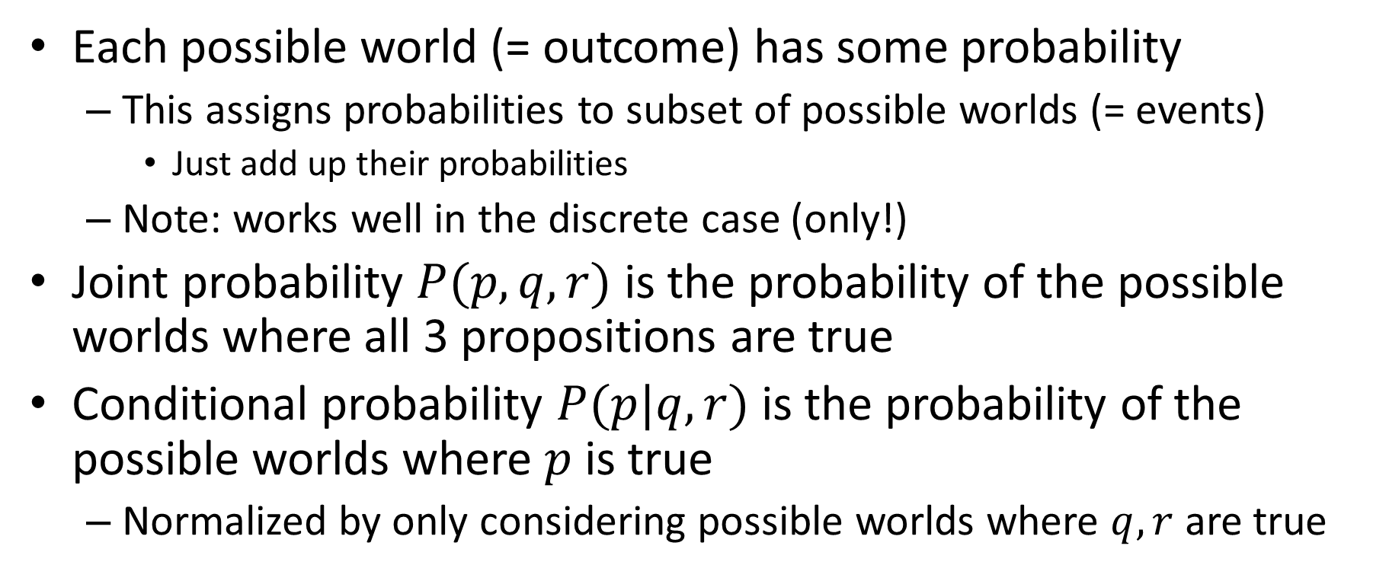
Possible worlds
Each possible world (= outcome) has some probability
This assigns probabilities to subset of possible worlds (= events)
Just add up their probabilities
Note: works well in the discrete case (only!)
Joint probability $P(p,q,r)$ is the probability of the possible worlds where all 3 propositions are true
Conditional probability $P(p|q,r)$ is the probability of the possible worlds where $p$is true
Normalized by only considering possible worlds where $q,r$ are true

Slide 13

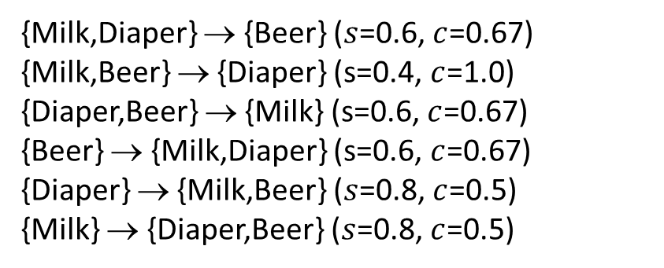
Association rule learning
All rules with support $≥s$and confidence $≥c$
We focus on finding sets with large support (why?)
Called frequent (item) sets
Many rules from same item set, different $c$
{Milk,Diaper} → {Beer} ($s$=0.6, $c$=0.67) {Milk,Beer} → {Diaper} (s=0.4, $c$=1.0)
{Diaper,Beer} → {Milk} (s=0.6, $c$=0.67)
{Beer} → {Milk,Diaper} (s=0.6, $c$=0.67) {Diaper} → {Milk,Beer} ($s$=0.8, $c$=0.5)
{Milk} → {Diaper,Beer} ($s$=0.8, $c$=0.5)
Notes:
Rule: A → B
Added value is P(B|A) – P(B)
Lift is P(B|A)/P(B)
These are not used consistently

Slide 14
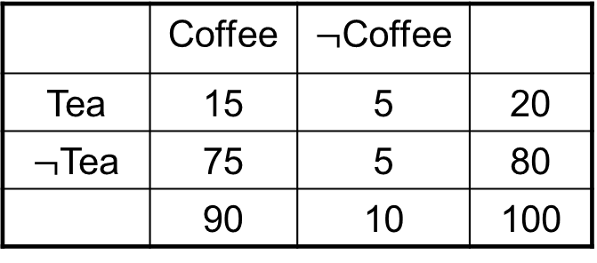
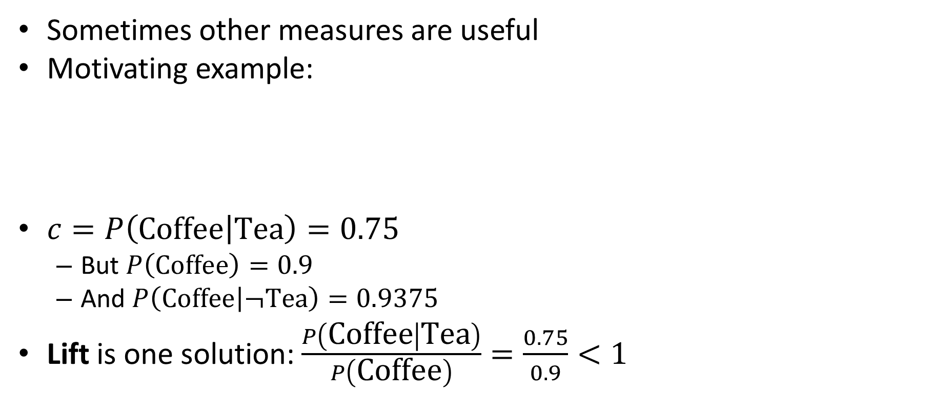
Beyond confidence
Sometimes other measures are useful
Motivating example:
$c=P\left(\text{Coffee} | \text{Tea}\right)=0.75$
But $P\left(\text{Coffee}\right)=0.9$
And $P\left(\text{Coffee} | ¬\text{Tea}\right)=0.9375$
Lift is one solution: $\frac{P\left(\text{Coffee} | \text{Tea}\right)}{P\left(\text{Coffee}\right)}=\frac{0.75}{0.9}<1$
 | Coffee | $¬$Coffee
Tea | 15 | 5 | 20
$¬$Tea | 75 | 5 | 80
 | 90 | 10 | 100

Slide 15
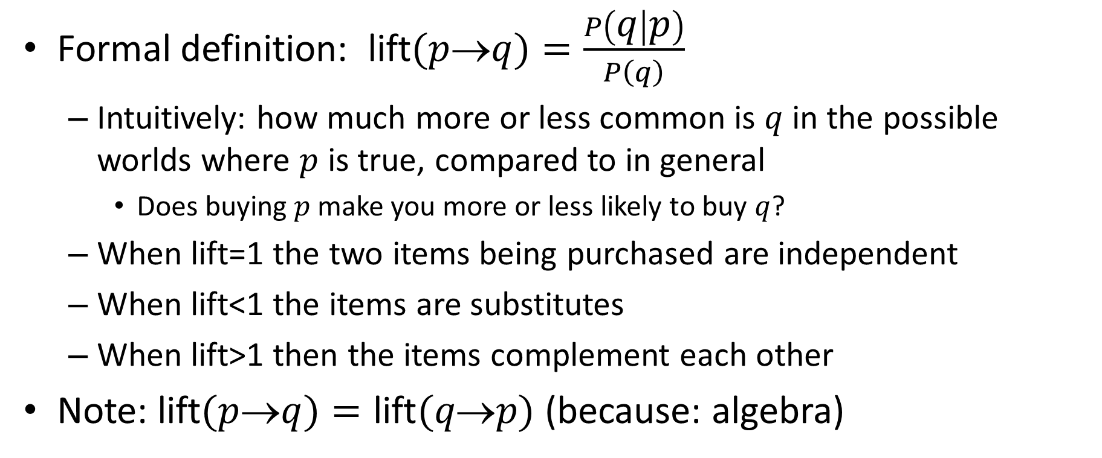
Lift and identities
Formal definition: lift$(p$→$q)=\frac{P\left(q | p\right)}{P\left(q\right)}$
Intuitively: how much more or less common is $q$ in the possible worlds where $p$ is true, compared to in general
Does buying $p$make you more or less likely to buy $q$?
When lift=1 the two items being purchased are independent
When lift<1 the items are substitutes
When lift>1 then the items complement each other
Note: lift$(p$→$q)=\text{lift}(q\text{→}p)$ (because: algebra)

Slide 16
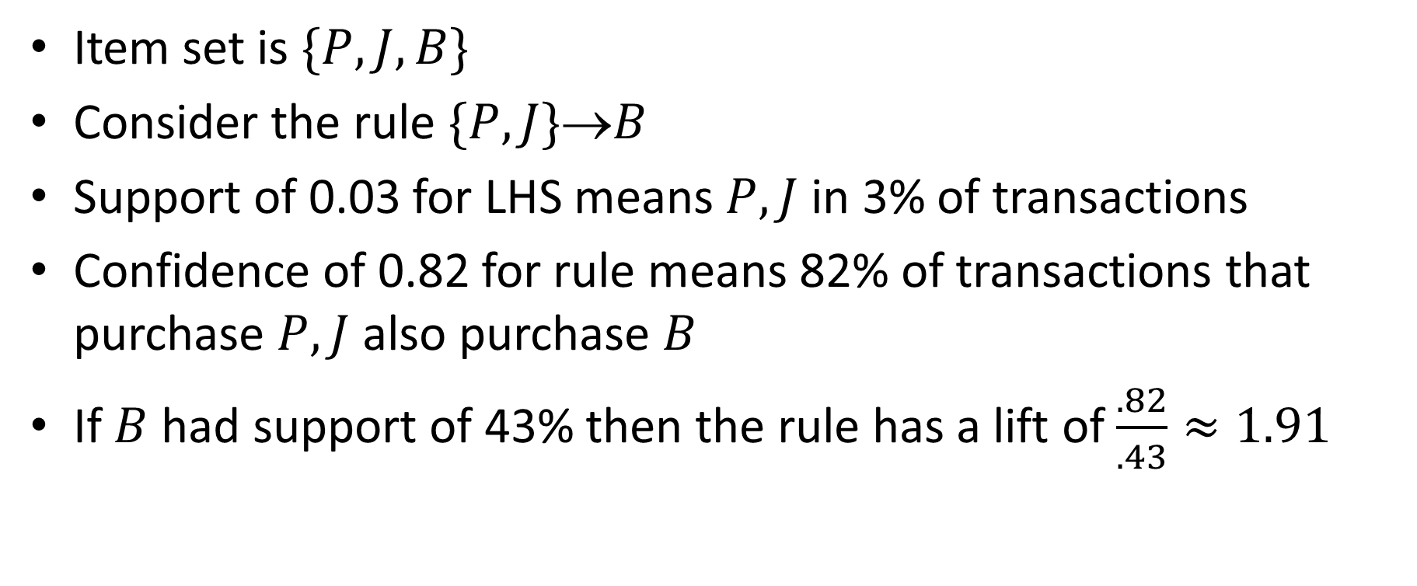
PB&J example
Item set is $\{P,J,B\}$
Consider the rule $\{P,J\}$→$B$
Support of 0.03 for LHS means $P,J$ in 3% of transactions
Confidence of 0.82 for rule means 82% of transactions that purchase $P,J$ also purchase $B$
If $B$ had support of 43% then the rule has a lift of $\frac{.82}{.43}≈1.91$

Slide 17

Fields of sets
Consider a set with $n$elements
We can arrange all of its $2^{n}$ subsets into a lattice
Via union and intersection
This structure is called a field of sets

Slide 18
Example
Harrington, Machine Learning in Action

Slide 19
The A Priori Principle
Problem: exponentially many item sets
As we grow an item set, its support goes down
If an item set is frequent, all of its subsets are frequent
How could beer and diapers be popular, if beer were not popular?
If an item set is infrequent, all of its supersets are infrequent
If beer and coke is infrequent, so is beer and coke and diapers

Slide 20
Example
Harrington, Machine Learning in Action

Slide 21
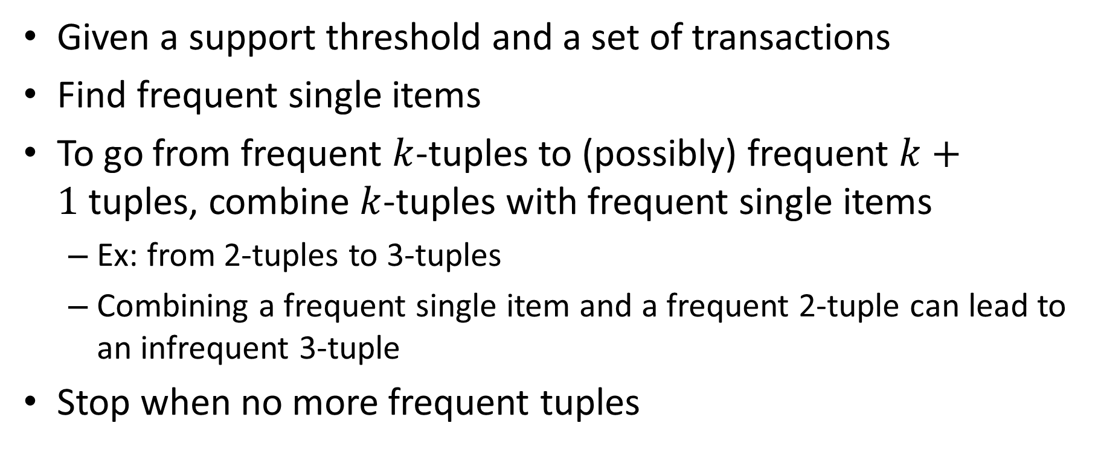
Apriori algorithm
Given a support threshold and a set of transactions
Find frequent single items
To go from frequent $k$-tuples to (possibly) frequent $k+1$tuples, combine $k$-tuples with frequent single items
Ex: from 2-tuples to 3-tuples
Combining a frequent single item and a frequent 2-tuple can lead to an infrequent 3-tuple
Stop when no more frequent tuples

Slide 22
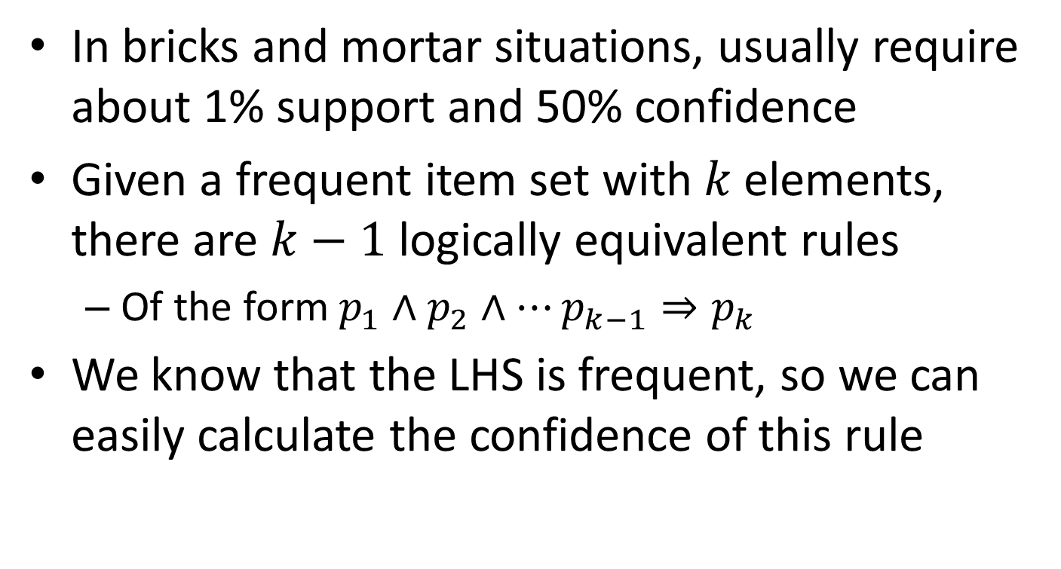
From frequent item sets to rules
In bricks and mortar situations, usually require about 1% support and 50% confidence
Given a frequent item set with $k$elements, there are $k−1$logically equivalent rules
Of the form $p_{1}∧p_{2}∧…p_{k−1}⇒p_{k}$
We know that the LHS is frequent, so we can easily calculate the confidence of this rule

Slide 23
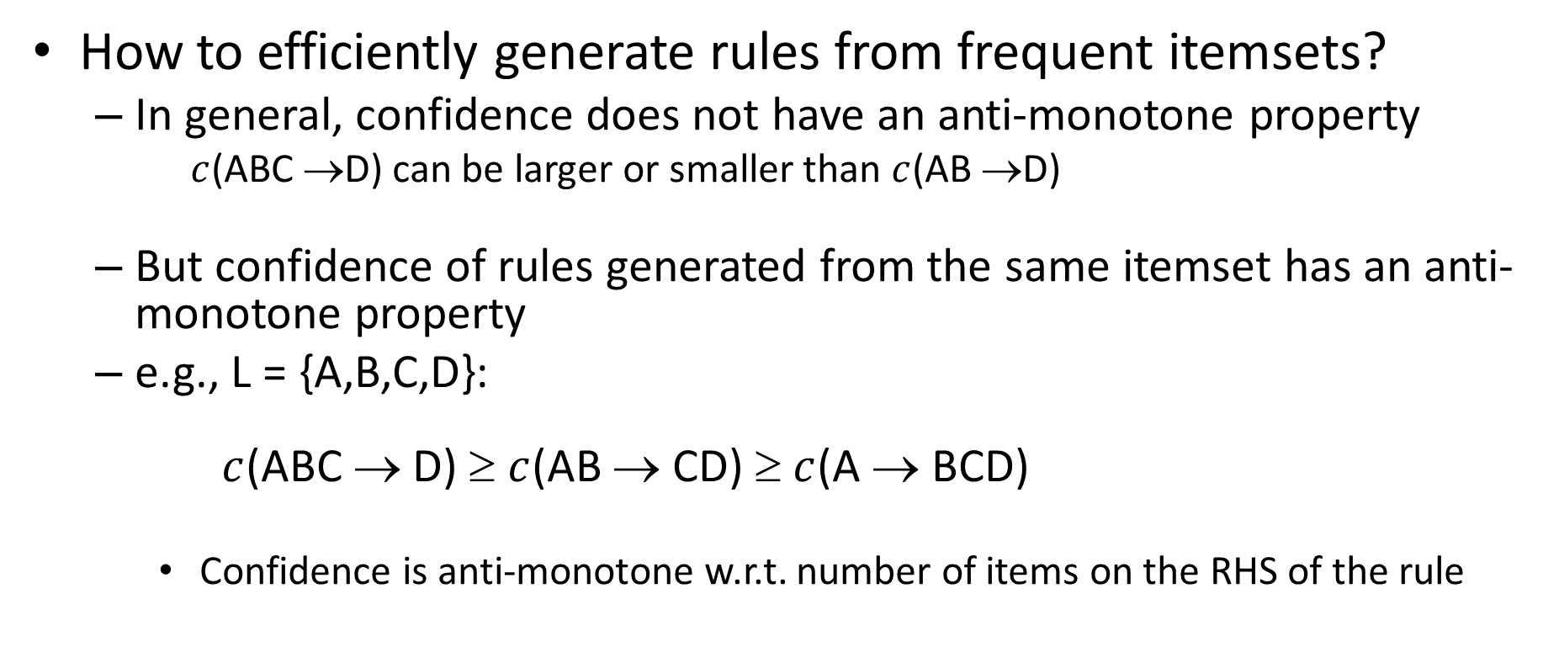
Rule Generation
How to efficiently generate rules from frequent itemsets?
In general, confidence does not have an anti-monotone property
$c$(ABC →D) can be larger or smaller than $c$(AB →D)
But confidence of rules generated from the same itemset has an anti-monotone property
e.g., L = {A,B,C,D}: $c$(ABC → D) ≥ $c$(AB → CD) ≥ $c$(A → BCD)
Confidence is anti-monotone w.r.t. number of items on the RHS of the rule

Slide 24
Apriori plus and minus
Plus: Fast, runs on huge data sets, easy to interpret
Rules with high confidence but low support are missed
Classic example: vodka → caviar
Very widely cited paper, many algorithmic variants
Ex: a transaction with no frequent itemsets can be ignored later
Including, for example, dynamic programming!

